Slide 1

Walmart Sales Analysis
SQL

Slide 2
Description of each column in the dataset
Invoice_ID: A unique identifier for each sales transaction.
Branch: The branch of the store where the transaction took place, represented by letters (e.g., A, B, C).
City: The city where the branch is located (e.g., Yangon, Naypyitaw).
Customer_type: The type of customer, indicating whether they are a member or a normal customer.
Gender: The gender of the customer (e.g., Male, Female).
Product_line: The category or product line of the items purchased (e.g., Health and beauty, Electronic accessories, Home and lifestyle).
Unit_price: The price per unit of the product.

Slide 3
Quantity: The number of units purchased in the transaction.
Tax_5%: The 5% tax applied to the total cost of the transaction.
Total: The total amount of the transaction, including tax.
Payment: The method of payment used by the customer (e.g., Cash, Credit card, Ewallet).
COGS (Cost of Goods Sold): The direct cost attributed to the production of the goods sold in the transaction.
Time: The time at which the transaction occurred, recorded in HH:MM
format.
Gross_margin_percentage: The gross margin percentage for the transaction, indicating the percentage of total
Sales revenue that is retained as profit after direct costs.
Gross_income: The income generated from the transaction after subtracting the cost of goods sold (COGS).
Rating: The customer’s rating of their shopping experience, typically on a scale of 1 to 10.

Slide 4
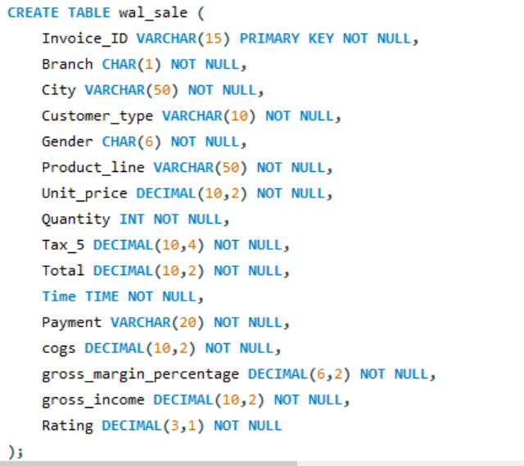
Creating Table in SQL

Slide 5
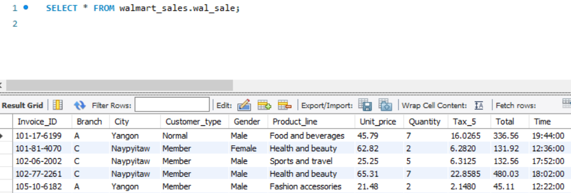
Import Data into Table

Slide 6
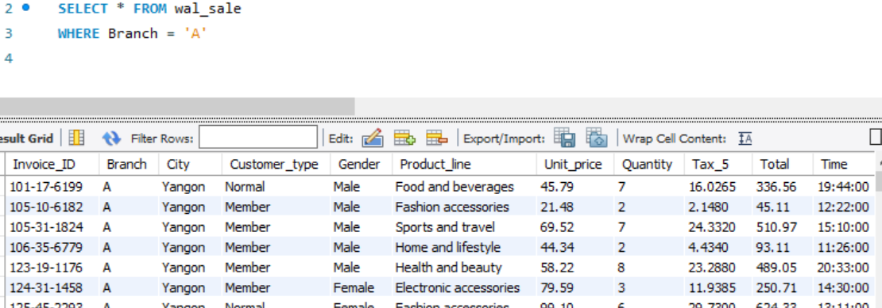
Retrieve all columns for sales made in a specific branch (e.g., Branch 'A').

Slide 7
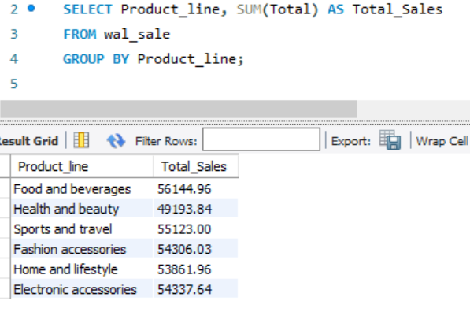
Find the total sales for each product line.

Slide 8
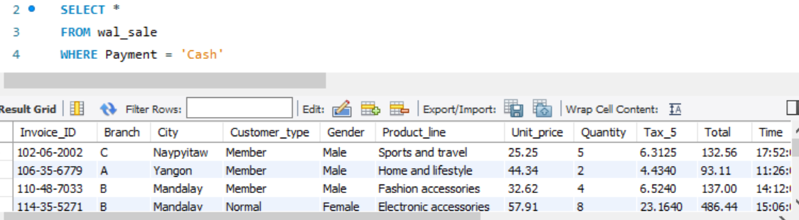
List all sales transactions where the payment method was 'Cash'.

Slide 9
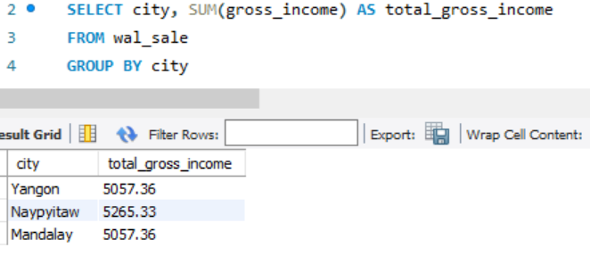
Calculate the total gross income generated in each city.

Slide 10
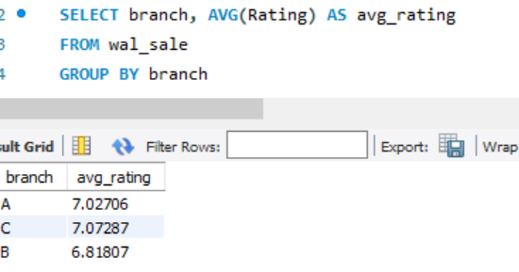
Find the average rating given by customers in each branch.

Slide 11
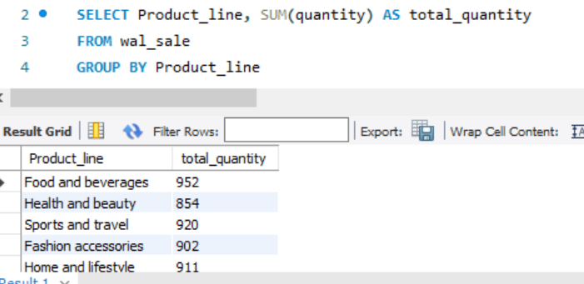
Determine the total quantity of each product line sold.

Slide 12
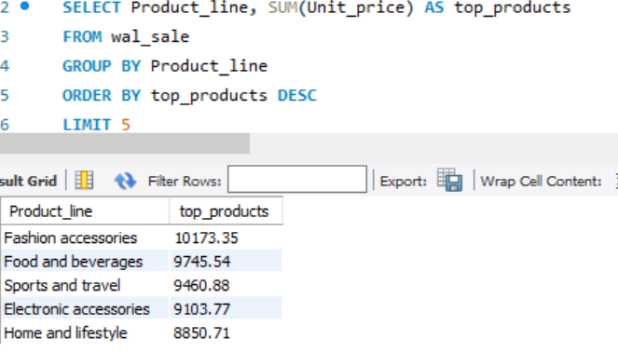
List the top 5 products by unit price.

Slide 13
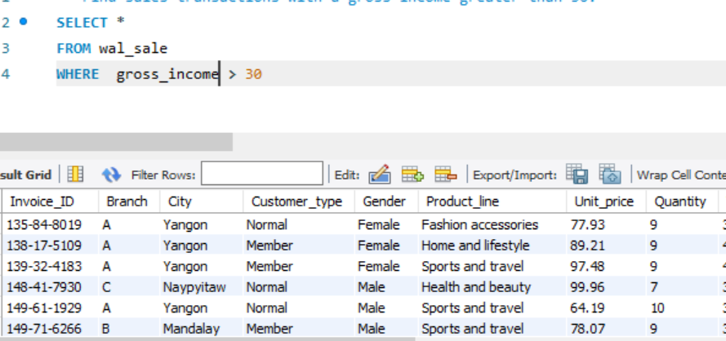
Find sales transactions with a gross income greater than 30.

Slide 14
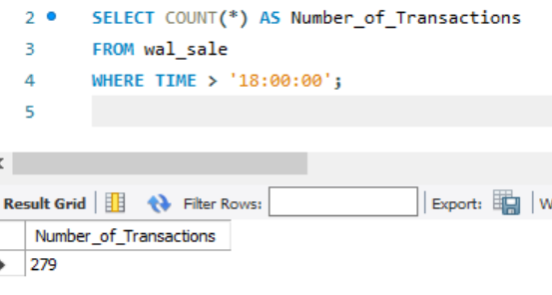
Find the number of sales transactions that occurred after 6 PM.

Slide 15
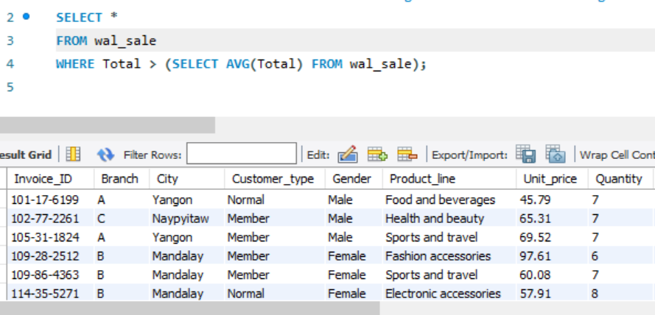
List the sales transactions that have a higher total than the average total of all transactions.

Slide 16
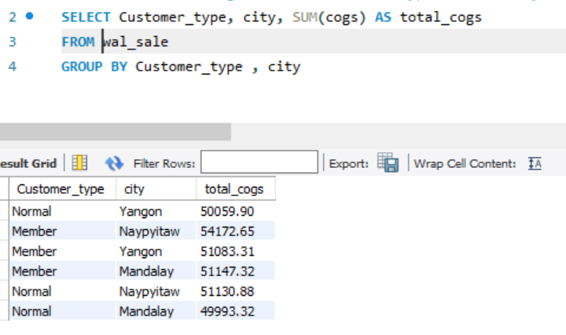
Find the total cogs for each customer type in each city.

Slide 17
INSIGHTS
Branch Sales: Assess Branch 'A's contribution to overall sales.
Product Line Sales: Identify top-selling and underperforming product lines.
Cash Transactions: Understand customer payment preferences.
Gross Income by City: Determine the most profitable cities.
Average Rating by Branch: Gauge customer satisfaction at each branch.
Quantity Sold: Manage inventory and forecast demand.
Top Products by Price: Highlight high-end, high-margin products.
High Gross Income Sales: Identify and replicate high-value transactions.
Weekend Sales: Analyze peak hours and weekend performance.
Monthly Sales: Understand seasonality and set targets.
Evening Sales: Evaluate performance after 6 PM for staffing and promotions.
Above-Average Transactions: Target high-value customers.
Cumulative Gross Income: Track branch growth over time.
COGS by Customer Type: Guide pricing and customer strategies.

Slide 18
THANK YOU
-RAMYASRI BISADI

